Slide 1


# S O T N 2 O 2 4

Slide 2




Ditch the Glitch: New Network Responsiveness Approaches for a Better Broadband User Experience
Mike Conlow Cloudflare
Dominique Lazanski
Nick Feamster
University of Chicago
Ermin Sakic NVIDIA

Slide 3

Latency (Delay): Bandwidth Isn’t Everything
Notes:
ISP last mile technologies deliver gigabit today (PON, DOCSIS)
BEAD grants are underwriting a significant gigabit FTTP expansion
Despite abundant bandwidth, users experience laggy gaming & glitchy conferencing!
Why?
WiFi Issues
Old networking gear & devices
LATENCY – AKA NETWORK RESPONSIVENESS
This session will explain what this lag is, what causes it, how it can be improved upon, and what future applications may emerge to take advantage of this advancement.

Slide 4

Latency: what is it & why it matters
Everything we believe about Internet performance is (mostly) wrong.
Bandwidth (aka speed) is important but is no longer the dominant performance factor. Post-Gigabit era of abundance – not scarcity
Nearly all end user Internet QoE issues can be attributed to latency.
Problem is - no one knows what latency is. (or if they do – they are wrong)

Slide 5
From IDLE to WORKING Latency
When you think of “latency” – think of “delay”, “responsiveness” or “response time”
Idle Latency: today’s artificial measure of responsiveness when a network connection is unused (Ex: BEAD 100ms latency threshold. Most fixed networks <20 ms.)
Working Latency: real-world measure of responsiveness when a network connection is being used (under load) (Ex: 100s – 1,000s of ms delay, widely varying over time)

Slide 6
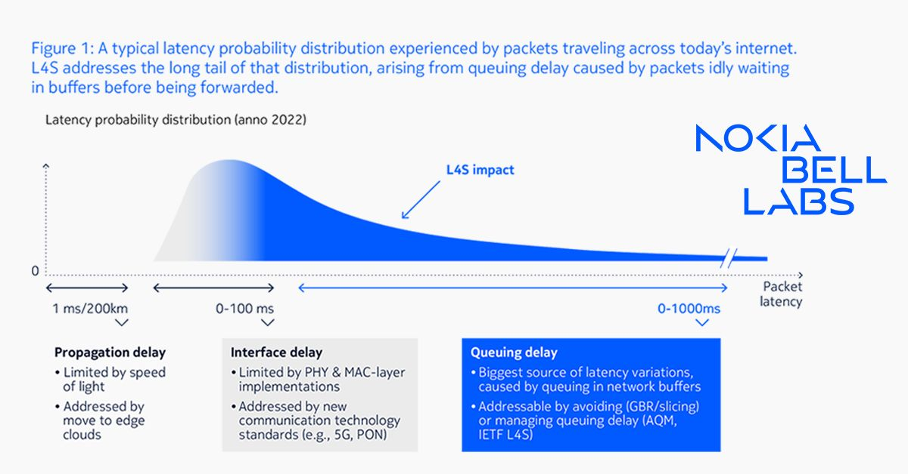
Main Lag Contributor: Network Queues
Image from Nokia

Slide 7
IETF Dual Queue Low Latency (L4S/NQB)
There is always a bottleneck link on the end-to-end path
Two fundamental traffic types = two network queues at bottlenecks
Incrementally deployable = does not hinge on internet-wide deployment
Loose coupling between layers (between network & app developer – very different from “network slicing”)
NN-Friendly Deployment Principles:
Only apps mark traffic, not the access network (e.g., via DPI)
Any app/edge provider should be able to use it – on a permissionless basis

Slide 8
Early Field Trial Experience
Over 50% reduction in working latency
Transforms the experience of cloud gaming
Creates strong foundation for AR/VR
Probably can improve many other user applications
Expect millions of US homes with dual queue low latency in 2024

Slide 9

Next to Our Panelists
Mike Conlow Cloudflare
Dominique Lazanski
Nick Feamster
University of Chicago
Ermin Sakic NVIDIA

Slide 10
Kick Off Questions
Measurement: How are you measuring working latency today and what have you been seeing? (Nick & Mike)
App Impact: What’s the customer impact of working latency when it is really good or really bad? (Ermin)
NN: How do regulators view dual queue networking? Is it a specialized service or just BIAS? Does it matter how it is implemented? (Dominique)
Future Apps: What sort of new applications may be possible once ultra low latency networking is available? (All)

